Slide 1
Investigating core periphery structure for centrality resilience, prediction and representation learning
Soumya Sarkar (15CS91P01)
Advisor: Prof Animesh Mukherjee

Slide 2
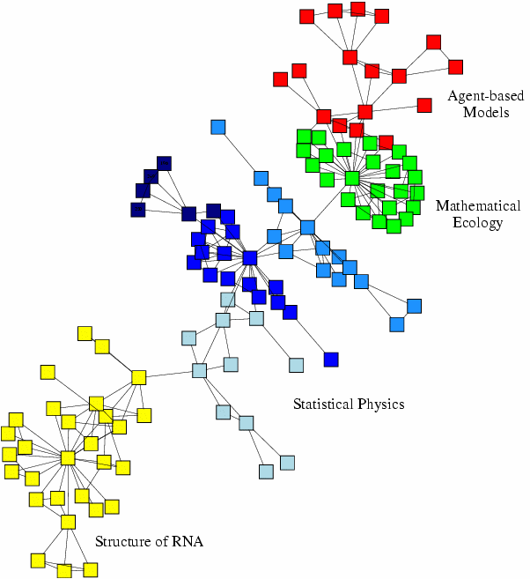
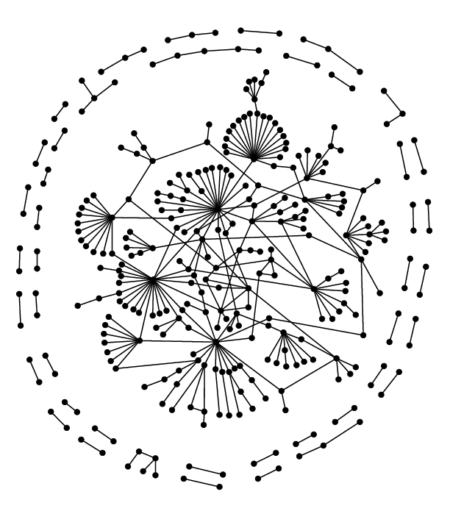
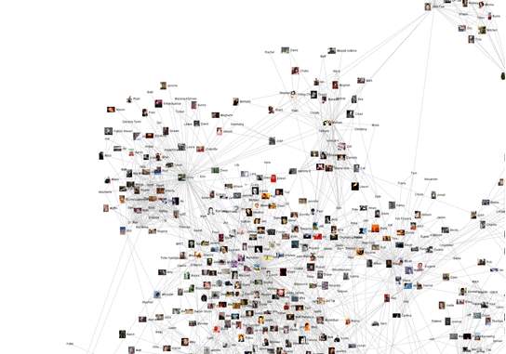
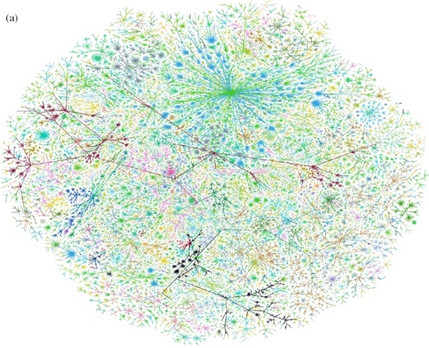
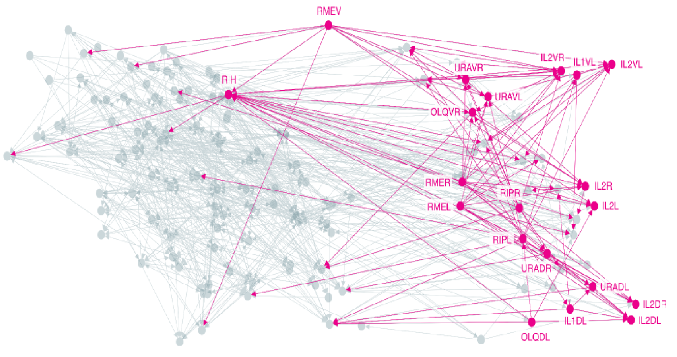
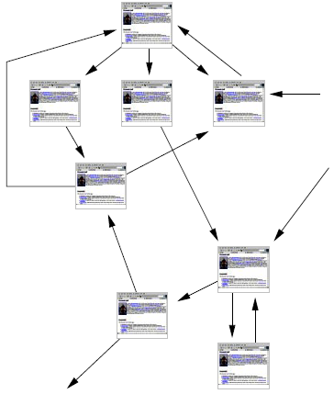
Networks are Ubiquitous
Economic networks
Biomedical networks
Social networks
Information networks: Web & citations
Internet
Networks of neurons

Slide 3

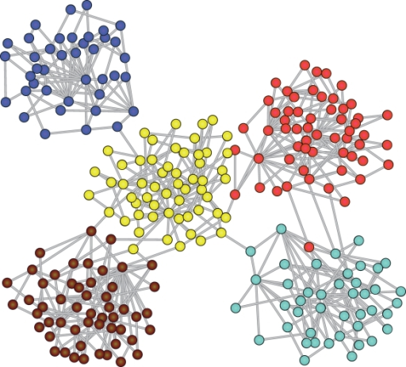
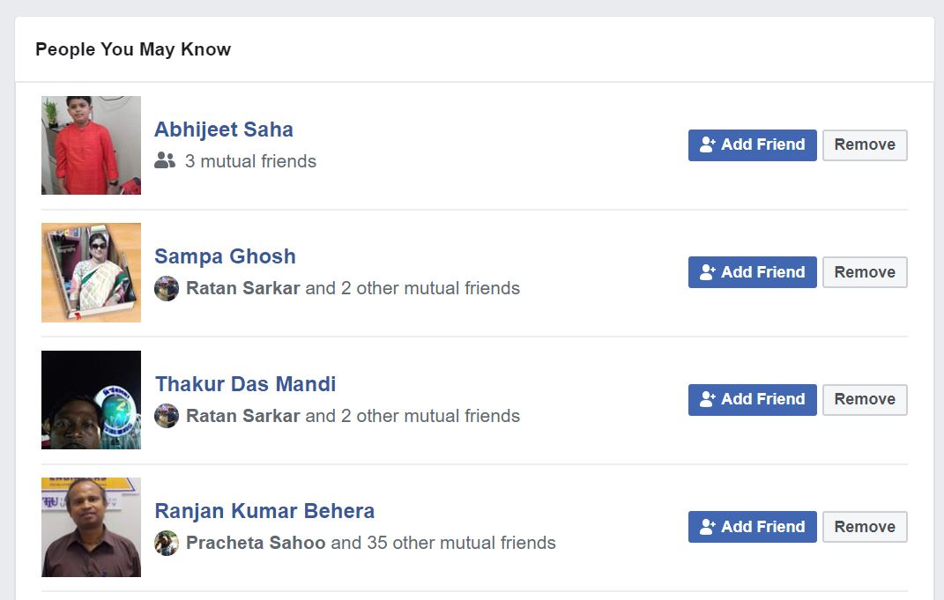
Information
diffusion
Community detection
Link Prediction

Slide 4
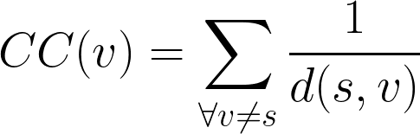
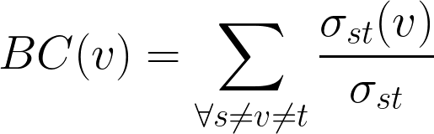
Centrality
One of the key problems in network analysis task is identifying influential nodes
Influence can be measured using centrality metrics
Closeness Centrality
d(s,v) ⟶shortest dist between s,v
Betweenness Centrality
𝜎_{st} ⟶ no. of shortest paths between s,t

Slide 5
Problems
Centrality metric is expensive to compute for large graphs
Key Research Question:
Can we use intrinsic network organization to discover central nodes?
What organizational properties do networks have where explicit computation can be avoided?
Can we utilize such properties in both static and dynamic graphs?

Slide 6
Key structure we study for our objective:
Core periphery organisation

Slide 7
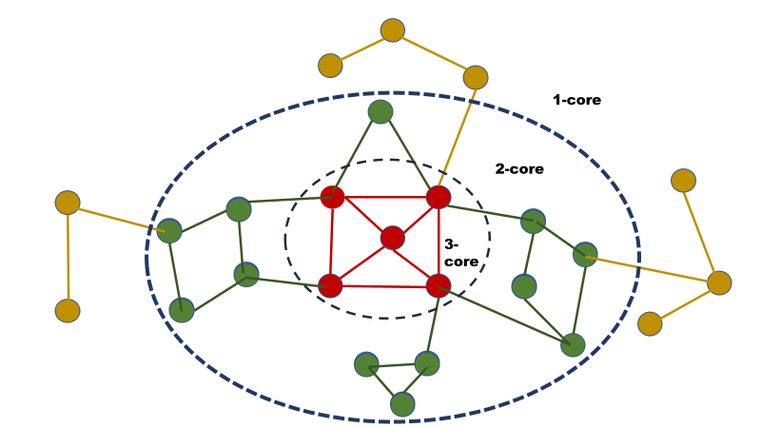
Graph degeneracy uncovered by k-core decomposition¹
Linear to the size of the graph
Scalable to large scale graphs
Fast and easy to compute
[1] Batagelj et. al. 2003

Slide 8
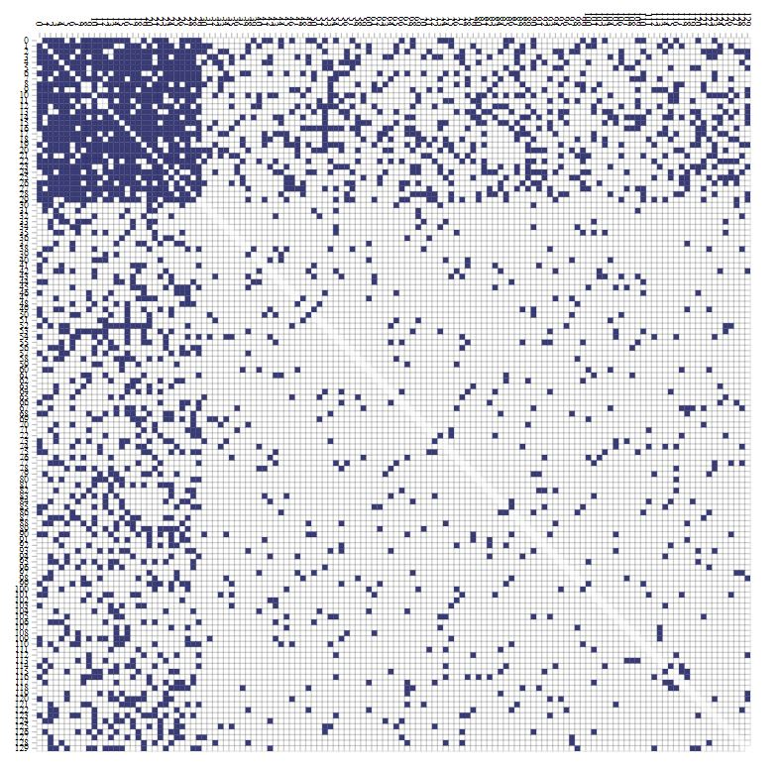
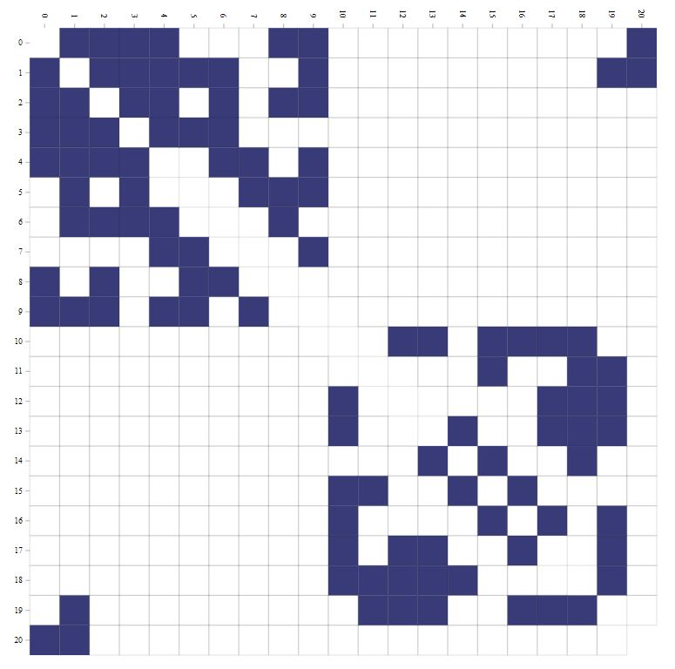
Ideal core periphery
Structure adjacency matrix
Ideal community
Structure adjacency matrix

Slide 9
Objectives of thesis
Studying rich centrality clubs in networks
Identifying influential nodes in time varying networks
Network representation learning using k-core structure

Slide 10
Studying rich centrality clubs in networks
CIKM 2018 ( Core A)

Slide 11
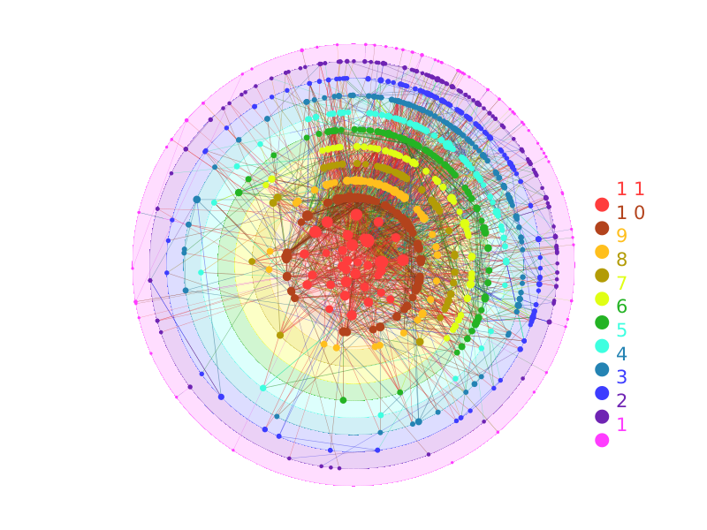
Hypothesis
Real world networks are often organised into hierarchical shells uncovered by k-core decomposition.
Since inner cores are dense by definition, members of
inner core connect pair of nodes in multiple shells.
We ask following Research Questions
RQ1: Innermost core a container for globally influential nodes?
RQ2: How inner core nodes organized in communities?
RQ3: What role does inner core nodes play in information propagation in the network?

Slide 12
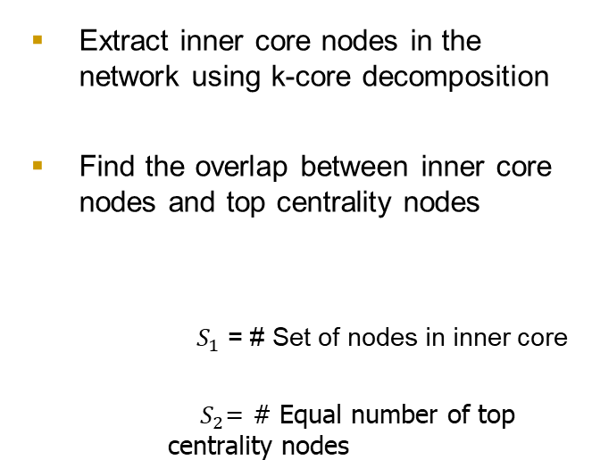
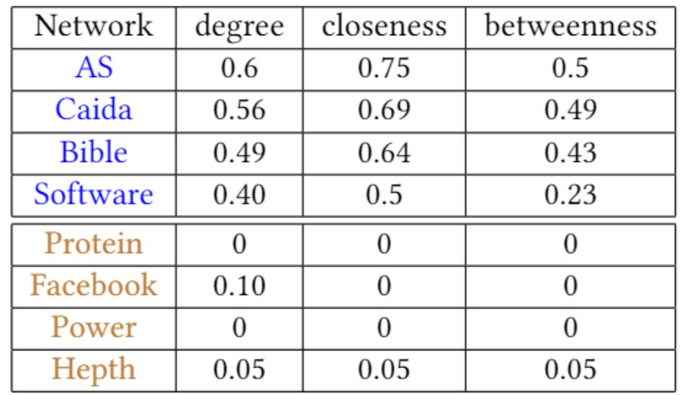
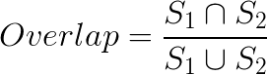
RQ1: High core → High centrality ?
Our intuition i.e. high core imply high centrality does not hold in all networks

Slide 13
RQ2: High Core in Communities
Extract communities using Louvian method²
Order communities in order of size
Find top core nodes in communities
Our results show distinguishing characteristics in networks
[2] Blondel et. al. 2011

Slide 14
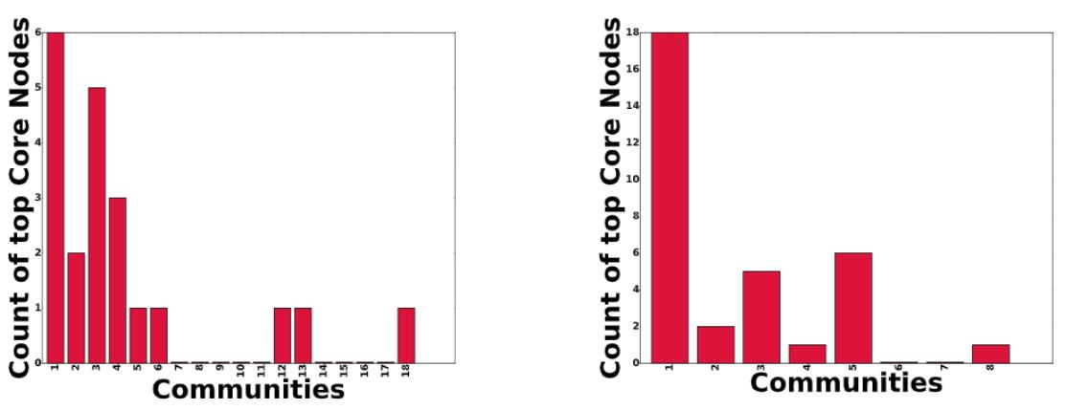
High core nodes distributed across multiple communities

Slide 15
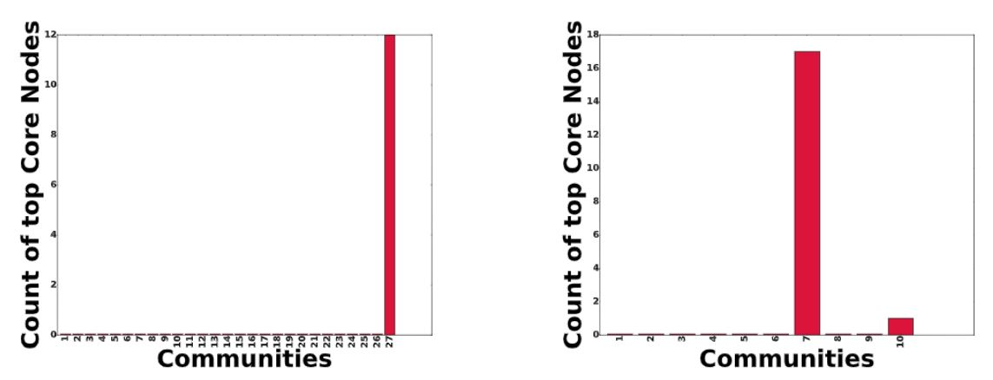
High core nodes localised in one community

Slide 16
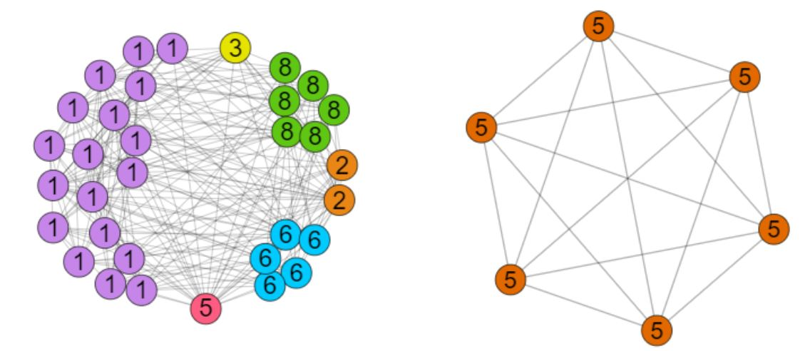
Key Takeaways
Top core nodes distributed in multiple communities
Top core nodes concentrate in single community

Slide 17
RQ3: Information through inner core
Extract communities using Louvian Method
Form meta network with
Communities and top k-core as supervertex, connections as edges
Rank nodes with respect to centrality
Original Network
Extract top core nodes using k-core
decomposition

Slide 18
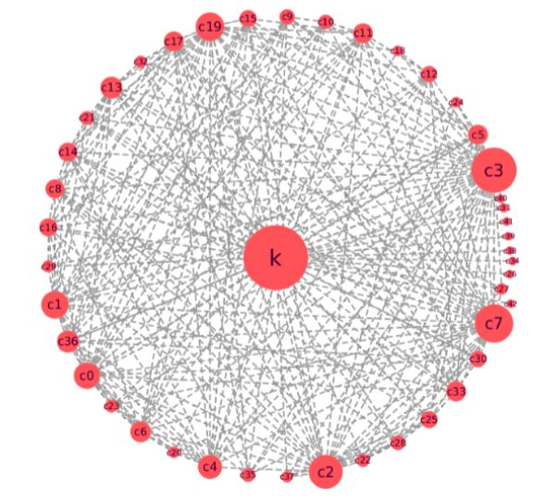
Representative example of the meta network
Node sizes are ordered by betweenness centrality value
Supervertex with max k core dominates other vertices in centrality.
Clearly a large fraction of shortest path traverse through the max k core.

Slide 19
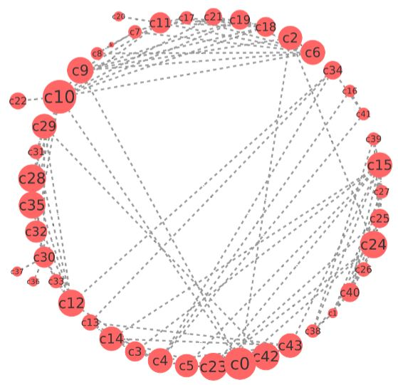
Representative example of the meta network for second class of networks
Clearly there is no supervertex with dominating centrality
Community based super vertices have comparable centrality values.

Slide 20
Key Takeaways
We coin inner most k-core subgraph which facilitate propagation of information in the network as rich centrality clubs (RCC)
Nodes part of RCC’s route majority of the information flow, i.e., they expand outwards
Influential nodes in RCC’s represent multiple communities in networks
Not all innermost core have RCC’s
Key insights from our experiments is that RCC’s act as bottleneck and expand outwards.
How do we quantify this?

Slide 21
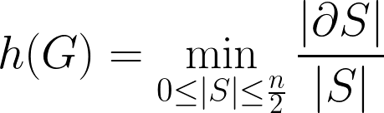
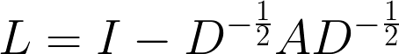
Cheeger’s constant
Cheeger’s constant approximated by second eigenvalue of the normalised Laplacian of the adjacency matrix.

Slide 22
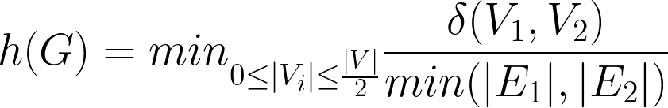
Cheeger’s constant
Cheeger’s constant approximated by second eigenvalue of the normalised Laplacian of the adjacency matrix.

Slide 23
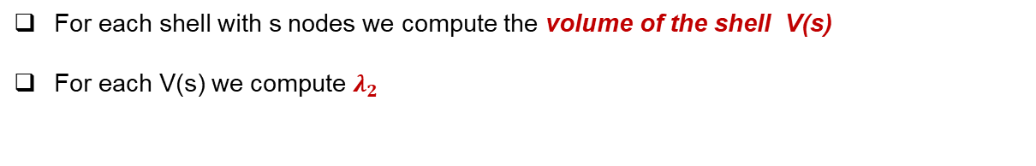
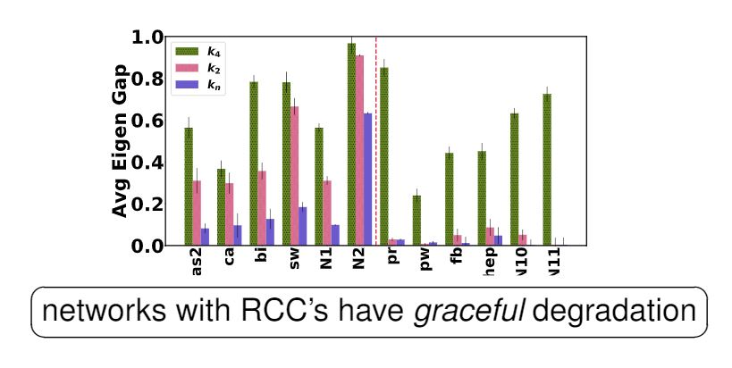

Slide 24
What does this imply?

Slide 25
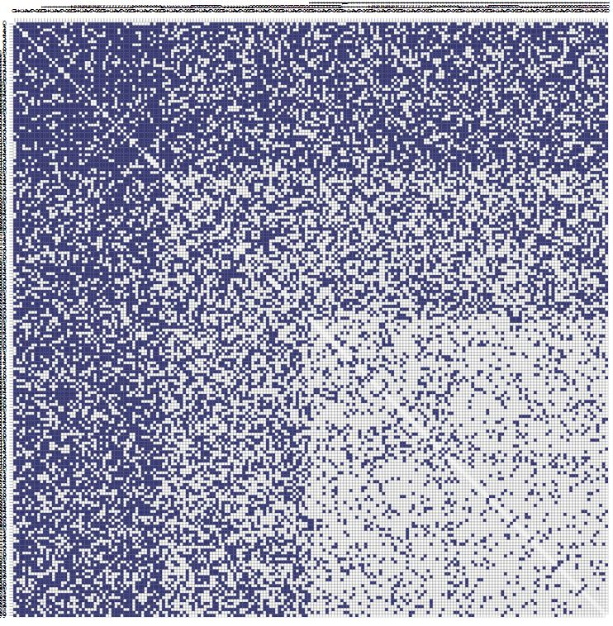
Dense innermost core
2nd inner most core
Gradually decreasing density

Slide 26
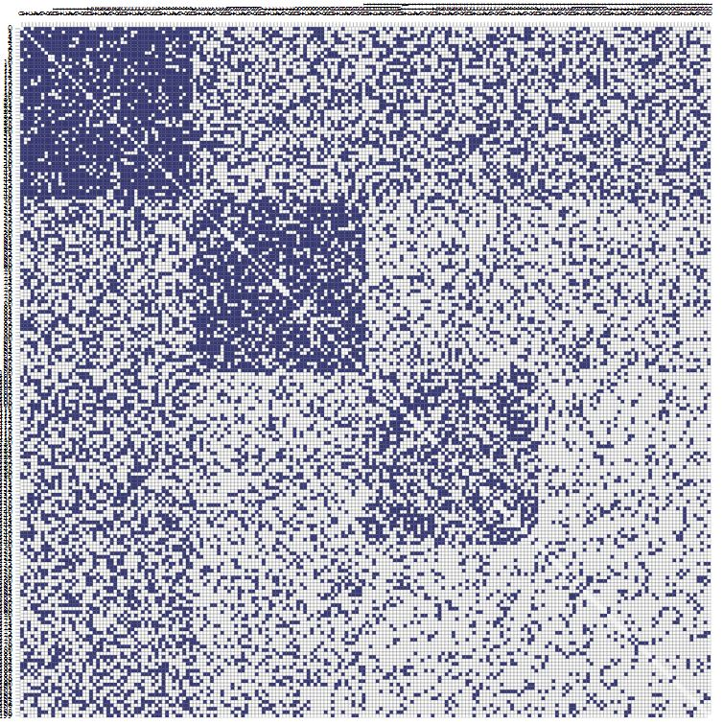
Dense Inner Core
Periphery broken into
communities
No distinct bottleneck

Slide 27
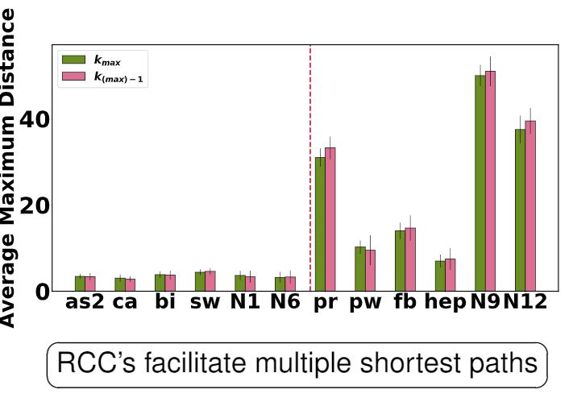
We also show a complementary experiment of expansion factor based on connectivity
For each non RCC node we calculate avg max distance with a rich club node

Slide 28
Applications
Following our exploration of the structure of networks with RCC’s, we now devise strategies to utilize their unique characteristics to solve certain tasks.
We consider two specific network functions
diffusion
robustness

Slide 29
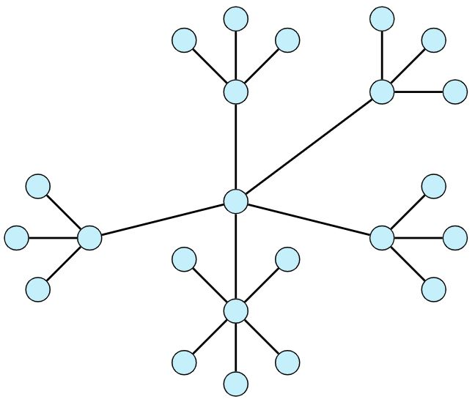
Diffusion Task
Original Network

Slide 30
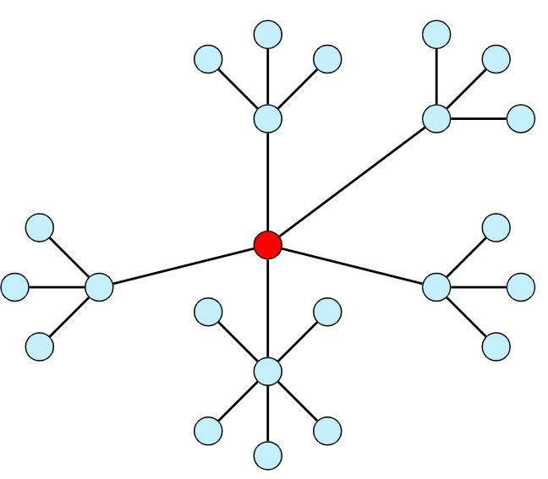
Step 1

Slide 31
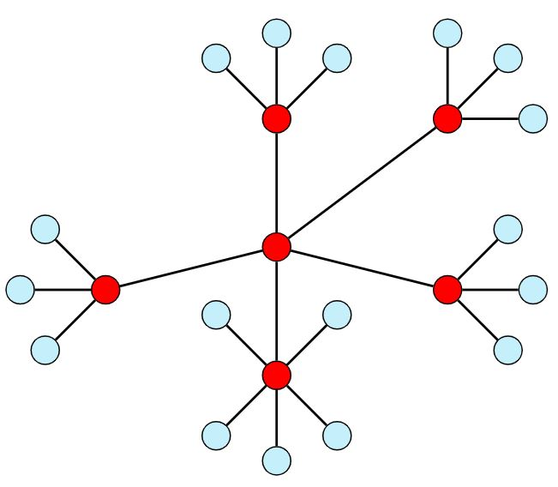
Step 2

Slide 32
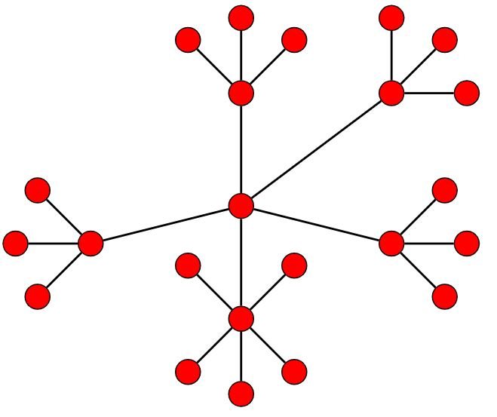
Step 3

Slide 33
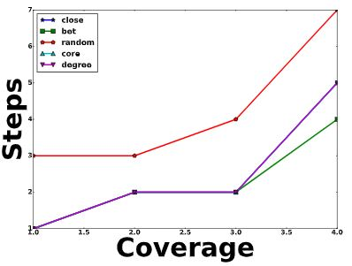
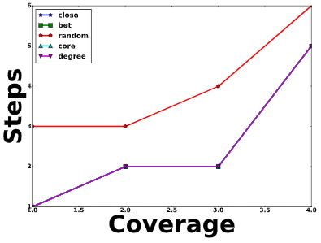
In networks with RCC, core based seed selection strategy works comparable to other techniques.

Slide 34
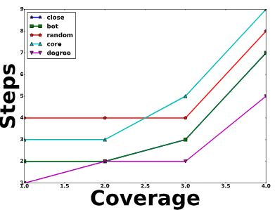
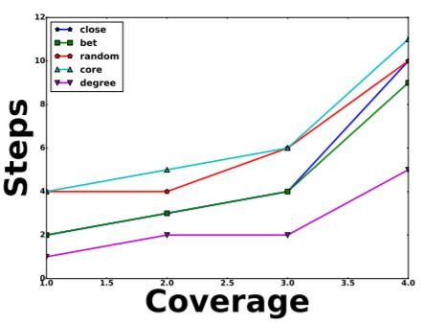
In networks without RCC, core based strategy works comparable to random selection of seed nodes.

Slide 35
Robustness Task
One of the desirable properties of a network is whether it can retain the ranking of its top-k high centrality nodes under perturbation of the network.
We have seen that RCC’s act as a bottle-neck in efficient information flow in the network.
High fraction of shortest path ⇒ redundancy.
Hence networks with RCC should be robust against minor perturbations.

Slide 36
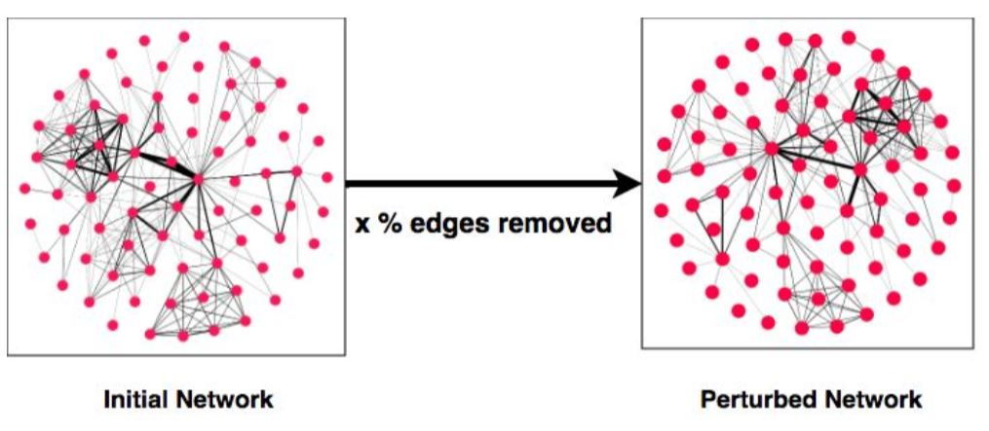
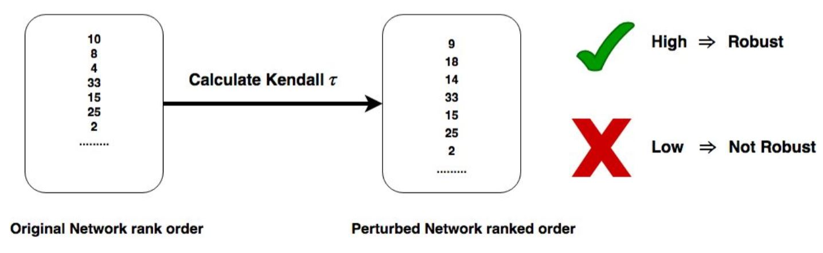

Slide 37
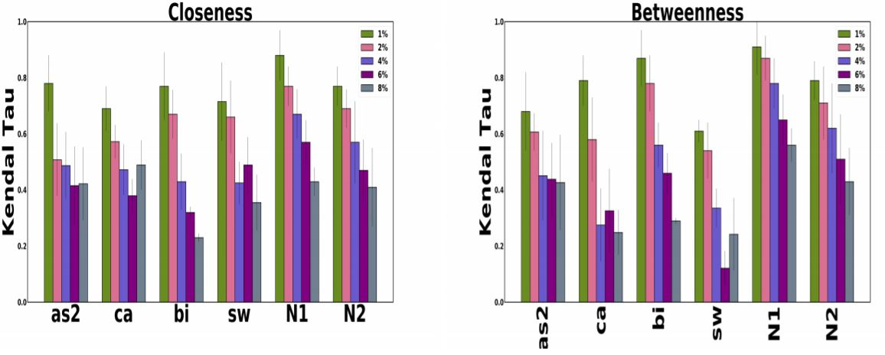

Slide 38
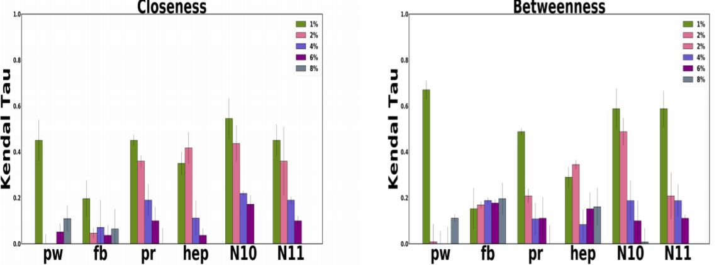

Slide 39
Scattered RCC
Our experiments show that in some networks RCC are located in the graph degeneracy
We hypothesize that RCC’s can be revealed by second order investigation of the original graph.

Slide 40
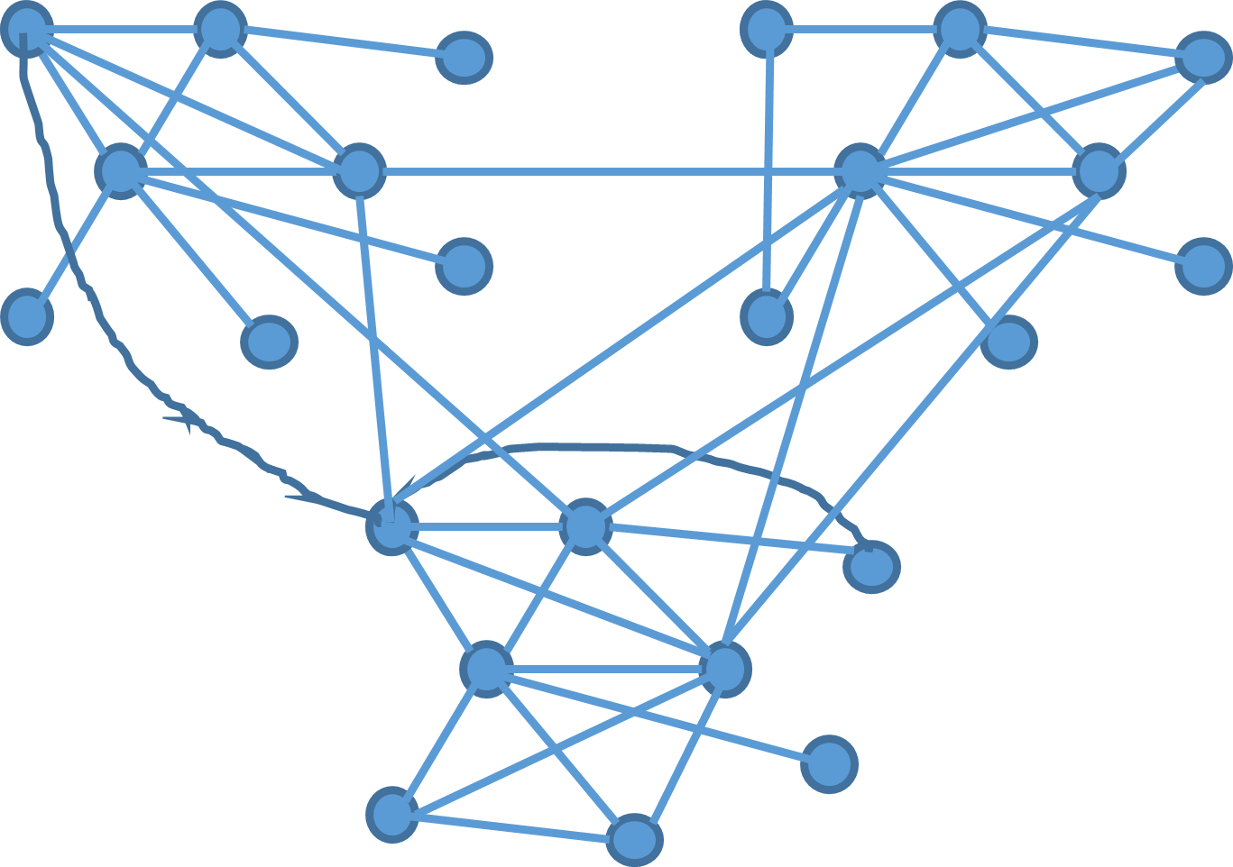
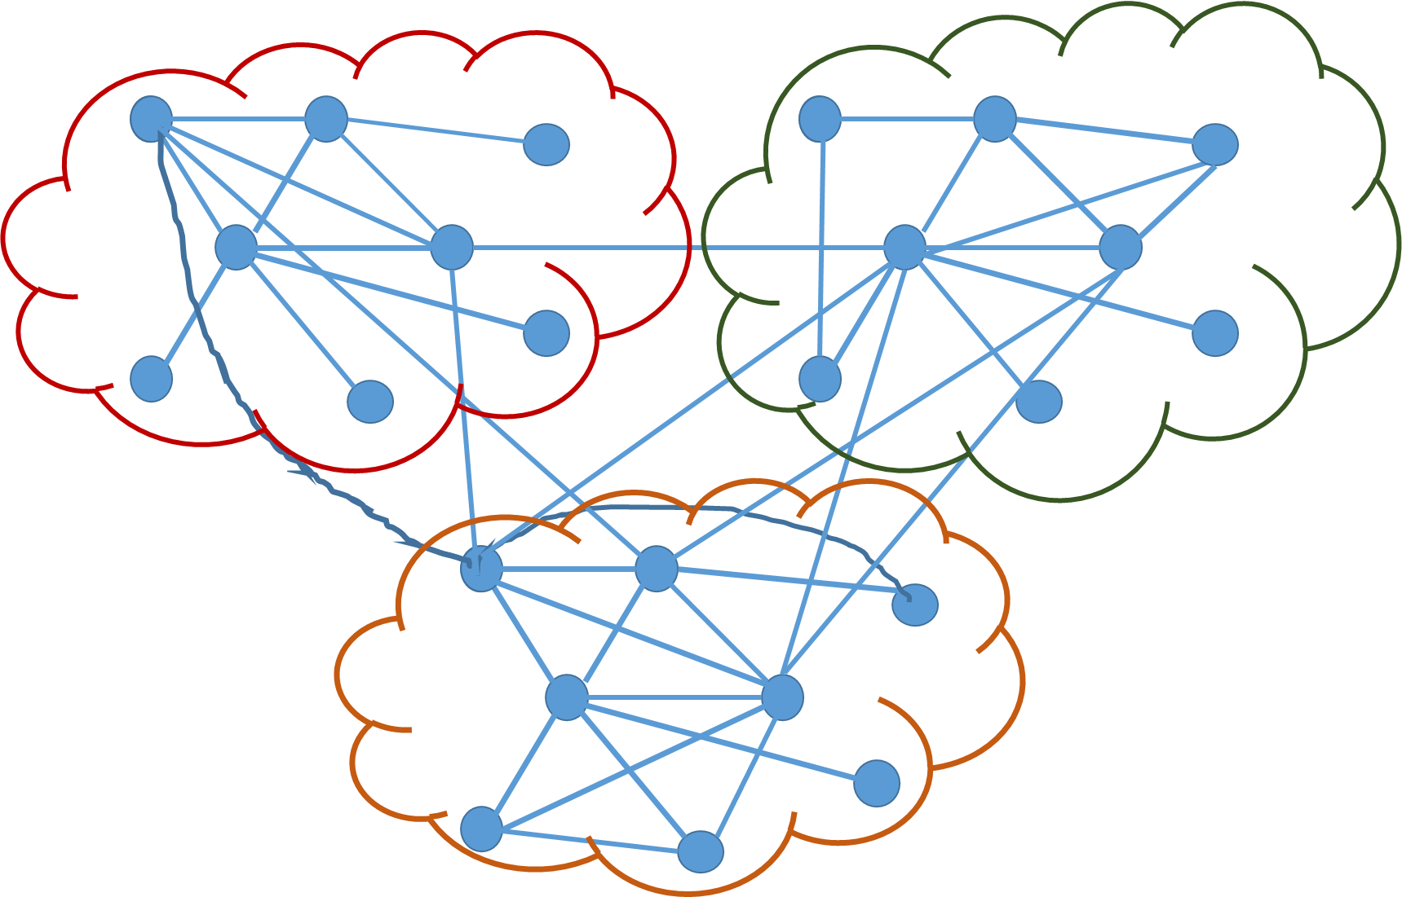
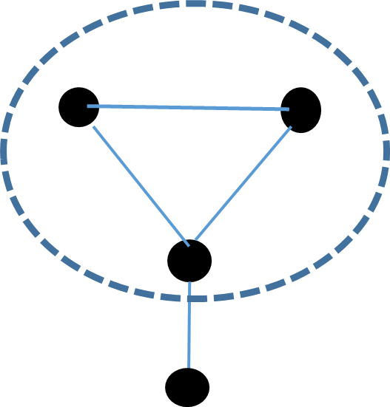
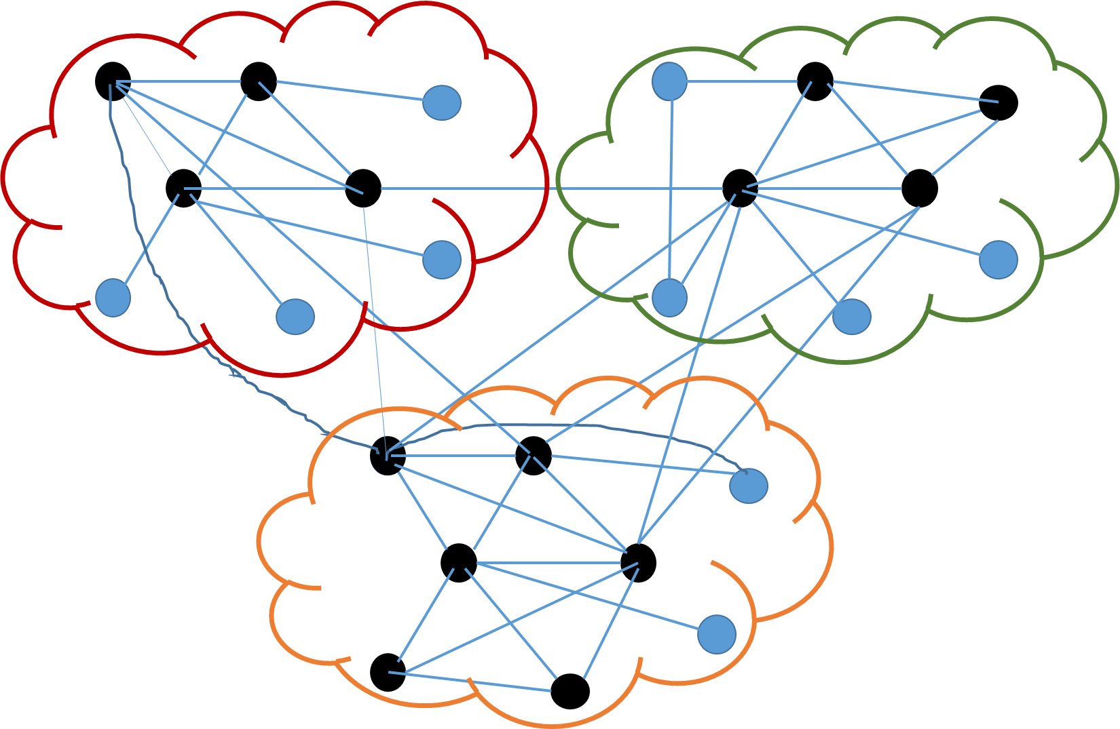
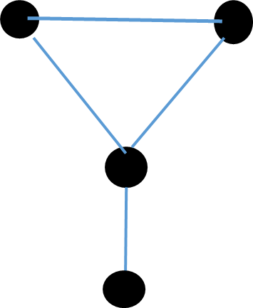
Original Network
Apply community detection
K-core detection
Meta Network
Meta Network
Apply CPM on individual clusters

Slide 41
Network | CC(% top 20) G (K_{max}) | BC(% top 20) G (K_{max}) | CC(% top 20) G’ (K_{max}) | BC(% top 20) G’ (K_{max})
as | 70 | 70 | 95 | 95
caida | 65 | 60 | 85 | 80
Bible | 65 | 60 | 85 | 80
Software | 65 | 65 | 90 | 85
hepth | 5 | 5 | 75 | 75
power | 0 | 0 | 45 | 25
protein | 0 | 0 | 70 | 65
facebook | 5 | 0 | 70 | 65
G(K_{max} ) →
Inner most core of original network
G’(K_{max} ) →
Inner most core of meta network

Slide 42
Summary of Chapter
We perform a rigorous series of experiments to show that innermost core of some networks act as rich club of path based central nodes.
We show distinguishing properties of networks in terms of information diffusion and robustness
We also develop novel second order network analysis approach to discover central nodes in the network.

Slide 43
Identifying influential nodes in time varying networks
ECML PKDD 2018 (Impact Factor : 3.644)

Slide 44
Motivation
Centrality metric is expensive to compute for large graphs
Closeness Centrality is O(V*E) for simple undirected unweighted graphs
Betweenness Centrality is O(E*V + N^2log(N)) for simple undirected weighted graphs
Studying Rich Centrality crks

Slide 45
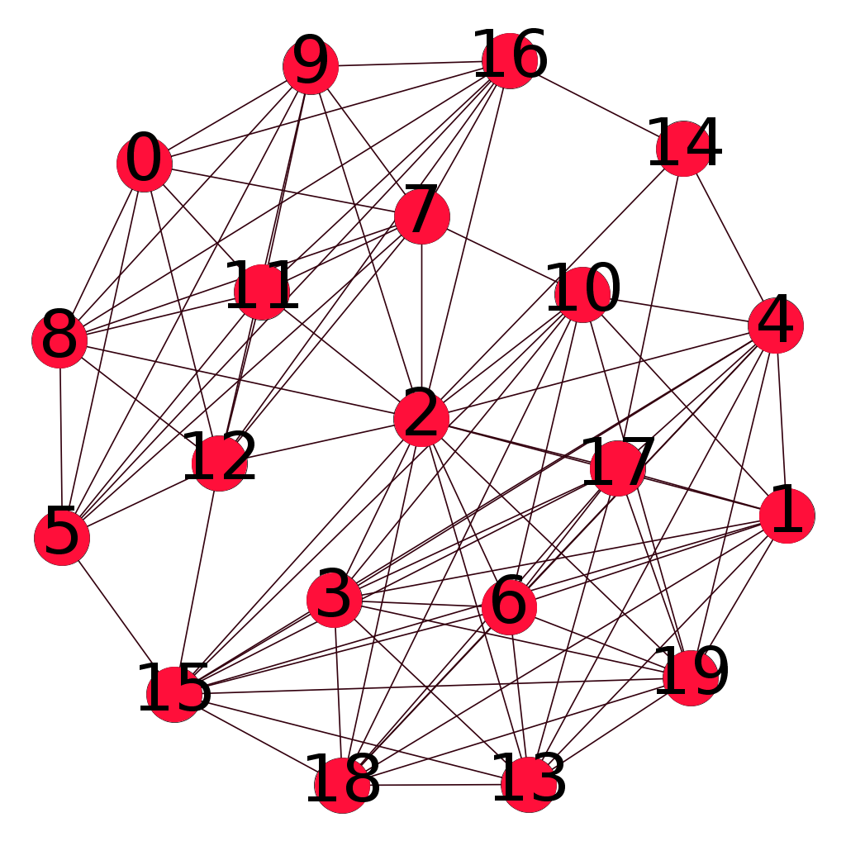
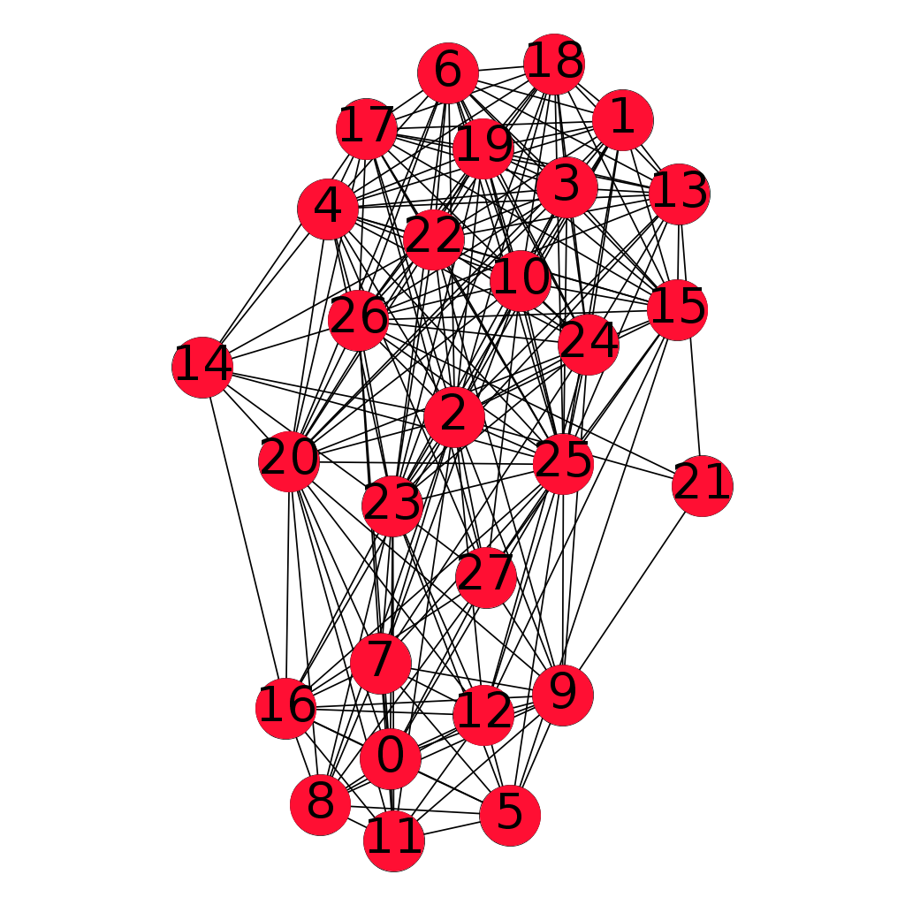
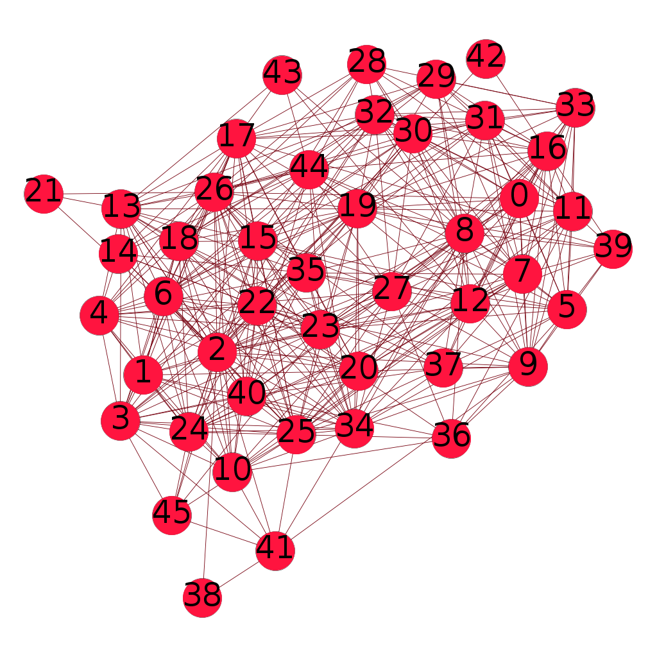
Motivation
Network
Snapshot 1
Network
Snapshot 2
Network
Snapshot 3
In temporal networks shortest path enumerations are required over multiple snapshots

Slide 46
Problem Statement
Given a series of temporal graphs where G_{(t-k)} is observed and G_{t} is unseen
G₁ ……. …G_{(t-k)}…….G_{t-1}……. G_{t} ✗
Can we identify network measures which can help us predict with higher certainty whether high central nodes in past time steps retain their importance?
G₁ …. G_{(t-k)} … G_{t-1}……. G_{t} ✓
Given G_{t} has arrived can we predict id’s of top high centrality nodes?

Slide 47
Hypothesis
We posit that if a dense group of vertices such as the innermost core exists and majority of shortest paths pass through this set then
High central vertices will also be part of this set.
Based on the persistence of this core over successive time steps we can predict high central nodes in future timesteps.
How to we check if a network conforms this property?
We provide a set of novel network measures to classify networks based on the extent to which they conform to our hypothesis.

Slide 48

Metrics
Fraction of inter-edges connected to the top core (EF)
Higher value desirable

Slide 49

Metrics
Density of the top-core (ED)
Higher desirable
Average density of the non-top cores (CD)
Lower desirable

Slide 50


Metrics
Top-core overlap (CO)
Higher desirable

Slide 51
Distribution Computation
EF
t computations
CD t computations
Network (N1)
With t time steps
Generate
cdf for
each metric
ED t computations
CO t-1 computations

Slide 52

Datasets
8 Real world networks used in our experiments. Synthetic networks generated by synthetic network generators such as Musketeer^{[3]}, Dancer^{[4]} also used.
3 A. Gutfraind et al
4 Benyahia, Oualid, et al

Slide 53
Classification Framework Overview
Cluster (G)
Generate CDF for each metric
for all networks
Cluster Networks based on a metric using
Hierarchical clustering
EF (G) > EF (B)
ED (G) > ED (B)
CD (G) < CD (B)
CO (G) > CO (B)
Cluster (B)

Slide 54


Slide 55
Prediction Framework
How does the classification help us?
Our experiments show that networks where majority of heuristics is assigned to G class, we predict the extent to which high central nodes retain their ranks using time series models

Slide 56
Prediction Framework
We use Auto-Regressive-Integrated-Moving-Average (ARIMA) model for prediction
On fitting ARIMA(p,d,q) model, we obtain an auto-regressive equation of the form
y_{t} = a₁y_{t-1}+...+a_{p}y_{t-p}+b₁e_{t-1}+...+b_{q}e_{t-q}+c

Slide 57

Prediction Point
Jaccard
Overlap
We calculate the overlap between top k high central nodes across consecutive time steps using Jaccard coefficient (JC).
Prediction of time t is calculated by regressing on JC between t-1 and t-w (w = window size)
Time
Autoregressive window
For a given time step t, the original overlap value is o_{t} and the predicted value is p_{t} , we define the error in prediction error (e_{t} ) as

Slide 58

Results for ARIMA Model

Slide 59

Results for AR, MA, ARMA models

Slide 60
Problem Statement I
G₁ ……. …G_{(t-k)}…….G_{t-1}……. G_{t} ✗
COMPLETED
Problem Statement II
G₁ …. G_{(t-k)} … G_{t-1}……. G_{t} ✓

Slide 61
Predicting top central nodes
Majority
Metric in cluster(G)
?
Calculate cdf for a new temporal network from previous t-1 values
for each metric
Classify each metric using nearest centroid method
Perform explicit computations
NO
YES
G_{t} available?
YES
Return top k high degree nodes of inner core nodes
Predict overlap of the top central nodes between G_{t-1} and G_{t}
NO

Slide 62

Our Method
We compare against global degree as well as existing baselines

Slide 63
Validation
We demonstrate that the behavior of our predicted high centrality vertices is very similar to the actual high centrality vertices in a practical context.

Slide 64
Validation
Strategy I (Closeness)
Select top 10 high central nodes by actual computation, predicted nodes and random choice
Start a diffusion process with the set as seed nodes
In each step all neighbours of the seed nodes are infected
Process stops when all nodes infected.
Calculate # of steps needed

Slide 65
Validation
Strategy II (Betweenness)
Select top 10 high central nodes by actual computation, predicted nodes and random choice
Remove the set of nodes from the network
Calculate diameter

Slide 66

Results with true centrality and predicted centrality are comparable

Slide 67

Results with true centrality and random nodes are comparable

Slide 68
Summary of Chapter
In this chapter we present a classification approach based on novel heuristics
We present a time series based prediction model for identifying identities of high central nodes in temporal networks.
We validate our prediction model against explicit computations.
Our approach achieves at least 8x improvements in computation time compared to traditional methods

Slide 69
Representation Learning using k-core structure
ASONAM 2018

Slide 70

Node Embeddings
Input
Output
Task: Find embedding of nodes to d-dimensions so that “similar” nodes in the graph have embeddings that are close together.

Slide 71

Problem Setup
Assume we have a graph G:
V is the vertex set.
A is the adjacency matrix (assume binary).
Encode nodes so that similarity in the embedding space (e.g., dot product) approximates similarity in the original network.

Slide 72
How do we train the encoder

Slide 73

probability that u and v co-occur on a random walk over the network

Slide 74


Estimate probability of visiting node v on a random walk starting from node u using some random walk strategy R.
Optimize embeddings to encode these random walk statistics.

Slide 75

Run short random walks starting from each node on the graph using some strategy R.
For each node u collect N_{R}(u), the multiset* of nodes visited on random walks starting from u.
Optimize embeddings according to:

Slide 76

Optimize embeddings to maximize likelihood of random walk co-occurrences.
Parameterize P(v | z_{u}) using softmax:
We make this computation scalable using negative sampling

Slide 77



Core based random walker
s₂
s₃
w
u
s₁
We use a biased 2nd-order random walks to explore network neighborhoods
Given the walker is at node w starting from node u, decision needs to be taken regarding next hop

Slide 78







Core based Random Walker
s₂
s₃
w
u
s₁

Slide 79

Core based Random Walker
s₂
s₃
w
u
s₁
λ determines probability to remain in vicinity of u
γ determines probability to explore further from u
Each parameter further weighted by penalised core distance

Slide 80

Metrics
Closeness: Sum of average cosine-similarity between each core-centroid and the nodes of that core. To normalize, divide by number of cores.
Separability: Average distance between all pairs of core-centroids.

Slide 81

Metrics results

Slide 82


Embedding comparison
node2vec
core2vec

Slide 83



Word similarity task
CosineSim / Human Judgement bases Ranking
(a1,b1) (a1,b1)
(a2,b2) (a3,b3)
….
Compute Spearman Rank Corelation

Slide 84

Word association networks
Network | Nodes | Edges
USF | 10590 | 63788
SWOW | 39,026 | 400622

Slide 85
Gold standard word pairs
SimLex999 snapshot:
WordSim353 snapshot:
MTurk snapshot:
old, new, 1.58
smart, intelligent, 9.2
hard, difficult, 8.77
happy, cheerful, 9.55
hard, easy, 0.95
short, long, 1.23
tiger, cat, 7.35
book, paper, 7.46
computer, keyboard, 7.62
computer, internet, 7.58
plane, car, 5.77
train, car, 6.31
access, gateway, 3.792
account, explanation, 2
account, invoice, 3.75
account, statement, 3.682
acoustic, remedy, 1.227
acrylic, cloth, 2.739

Slide 86
Evaluation method
Gold standards consist of a list of pair of words and corresponding similarity score.
We calculate the cosine similarity of word pairs from the learned word vectors
We calculate Spearman’s rank correlation between observed score and computed score.

Slide 87

Results
SWOW Dataset Results

Slide 88


PCA transformed
Node2vec
core2vec

Slide 89
Graph Neural Network (GCN) based influential node prediction

Slide 90

GCN Overview
Generate node embeddings based on local neighborhoods
Leskovec et. al.

Slide 91
Aggregation Technique
Node representation at k^{th} layer → Weighted aggregation of (k-1)^{th} layer

Slide 92
Application
A → R^{d}
Use Embeddings
In Downstream Prediction
Task
Possible to perform end to end training

Slide 93
Semi supervised approach
Our previous experiments show evidence that inner core nodes in the network act as proxy for influential nodes.
Inner core nodes can be used as positive labels in influence prediction task
Similarly outer core nodes can be assigned negative labels

Slide 94

Original Network

Slide 95

K-core identification on original network

Slide 96

Node labelling process

Slide 97

Top 3 nodes with positive predictions in terms of SoftMax probabilities

Slide 98



Core Based Masking
where
We introduce masking to remove high core distant edges
Where

Slide 99
Results
Network | GCN (CC) | GCN (BC) | Masked GCN (CC) | Masked GCN (BC)
Caida | 0.24 | 0.63 | 0.8 | 0.88
Protein | 0.46 | 0.64 | 0.84 | 0.89
Hepth | 0.24 | 0.28 | 0.7 | 0.9
Hepph | 0.5 | 0.4 | 0.6 | 0.86
AP@20

Slide 100
Summary of Chapter
We design a novel network embedding model Core2vec with a unique exploration strategy for context nodes guided by global information.
We illustrate an application of our embedding in word analogy task, where compare similar words scored by our method against manual curated gold standard scores
A novel SSL approach for ranking influential nodes based on core-periphery structure

Slide 101
Acknowledgement
I would wholeheartedly like to thank CNeRG group, which allowed me to interact and indulge in some of the most unique group of researchers and diverse set of topics.
I would like to thank all collaborators especially Dr. Sanjukta Bhowmick for fruitful discussions in various stages of this thesis.
Funding agencies such as ACL, ACM IARCS, SIGIR, Microsoft, CNeRG Travel Grant for funding my travel in conferences

Slide 102
Publications from this Thesis
Soumya Sarkar, Sandipan Sikdar, Sanjukta Bhowmick, and Animesh Mukherjee. Using core-periphery structure to predict high centrality nodes in time-varying networks. Data Mining and Knowledge Discovery 32, no. 5 (2018): 1368-1396. accepted in ECML PKDD 2018 Journal Track. (Impact Factor 3.644 )
Soumya Sarkar, Sanjukta Bhowmick, and Animesh Mukherjee On Rich Clubs of Path-Based Centralities in Networks In Proceedings of the 27th ACM International Conference on Information and Knowledge Management, pp. 567-576. ACM, 2018 ( Core A )
Soumya Sarkar, Aditya Bhagwat , Animesh Mukherjee Core2Vec: A Core-Preserving Feature Learning Framework for Networks. In 2018 IEEE/ACM International Conference on Advances in Social Networks Analysis and Mining (ASONAM), pp. 487-490. IEEE, 2018.
Soumya Sarkar, Aditya Bhagwat, and Animesh Mukherjee. A core-periphery structure based network embedding approach. (Communicated to SNAM ). (Impact Factor 1.644 )

Slide 103
Publications outside Thesis
# 2 (Core A*) , 3 (Core A)
Bhanu Prakash Reddy Guda*, Sasi Bhushan Seelaboyina*, Soumya Sarkar* , Animesh Mukherjee (*equal contribution) NwQM: A neural quality assessment framework for Wikipedia In Proceedings of the 2020 Conference on Empirical Methods in Natural Language Processing (EMNLP'20) , pages xx–-xx, 2020. ( Core A)
Binny Mathew, Anurag Illendula, Punyajoy Saha, Soumya Sarkar, Pawan Goyal, Animesh Mukherjee Hate begets Hate: A Temporal Study of Hate Speech. Proceedings of the ACM on Human-Computer Interaction (CSCW 2020) ( Core A)
Soumya Sarkar, Suhansanu Kumar, Sanjukta Bhowmick, and Animesh Mukherjee. Centrality and Community Scoring Functions in Incomplete Networks: Their Sensitivity, and Reliability. In Machine Learning Techniques for Online Social Networks, pp. 135-154. Springer, Cham, 2018
S. Sarkar, B. P. Reddy, S. Sikdar, and A. Mukherjee. StRE: Self attentive edit quality prediction in Wikipedia.In Proceedings of the 57th Annual Meeting of the Association for Computational Linguistics, pages 3962-3972, Florence, Italy, July 2019. Association for Computational Linguistics ( Core A*)

Slide 104
Publications outside Thesis
Soumya Sarkar, Suhansanu Kumar, Sanjukta Bhowmick, and Animesh Mukherjee. Sensitivity and reliability in incomplete networks: Centrality metrics to community scoring functions. In 2016 IEEE/ACM International Conference on Advances in Social Networks Analysis and Mining (ASONAM), pp. 69-72. IEEE, 2016.
Ufimtsev Vladimir, Soumya Sarkar, Animesh Mukherjee, and Sanjukta Bhowmick. Understanding stability of noisy networks through centrality measures and local connections. In Proceedings of the 25th ACM International on Conference on Information and Knowledge Management, pp. 2347-2352. ACM, 2016. (Core A)
Sandipan Sikdar, Tanmoy Chakraborty, Soumya Sarkar, Niloy Ganguly, and Animesh Mukherjee. 2018. ComPAS: Community Preserving Sampling for Streaming Graphs. In Proceedings of the 17th International Conference on Autonomous Agents and MultiAgent Systems (AAMAS ’18), 184-192. (Core A*)

Slide 105
Prof Wolfgang Nejdl
Q1) Provide both theoretical arguments and practical examples on the relevance and significance of your extension of the rich club concept covering centrality instead of node degree and connect those to specific datasets you have been investigating, discussion similarities and differences between these networks.

Slide 106


Slide 107
Contd..
Q2) Describe in more detail your approach to making networks more attack resilient for different attacks and how this possibly changes or not these networks and their properties
We proposed a network modification strategy to increase resilience of networks, against perturbation of rank order among top central nodes. Our approach is inspired by small world network generation by Watts–Strogatz model where a random rewiring of edges is employed over a lattice network to decrease the average path length. We can first compute dense substructures or communities in the network using Louvian algorithm. We connect inter community nodes preferentially based on community size and node degree. This creates a dense core through which communities interact among themselves. This clarification has now been added to the revised thesis in section 3.6 page 56.

Slide 108
Contd..
Q3) Characterize the networks which have no significantly high closeness, betweenness centrality vertices show how you can detect this and speculate about possible reasons for this phenomenon and what would have to change in the application domain such that these vertices would appear
We speculate that network without a RCC does not have significantly high closeness, betweenness centrality vertices. In such networks the majority of the communities do not meet through the inner core. This indicates that the inner core is not at any special position with respect to the paths connecting the communities. One example model of such a network would be a ring of cliques of different sizes.

Slide 109

Contd..
The smaller cliques can have connections between them. An toy example is given in below figure. Here the highest core is at the side of the network rather than the center. If the network contains RCC, then the inner shells are expander like, and communities meet at the RCC. An example model conforming to this structure would be a large clique in the center surrounded by smaller cliques shown below. We propose a pipleline for detecting high central nodes in such cases in Section 3.4 page 48 of the thesis

Slide 110
Contd..
Q4) Discuss the main differences of core2vec to other approaches, what you are different than others and why core2vec in better than these approaches.
The main difference between core2vec and existing approaches is that the latter approaches are agnostic to the inherent organization of the nodes in the network. Core2vec is however explicitly conditioned on the organization of the nodes in the network. More specifically the random walk decisions taken at each step in core2vec is conditioned on the core membership of the current node and its neighbor. Hence neighborhood multiset is not likely to contain members with very large core distance from the starting node. This approach is based on the assumption that similar core nodes have more in common compared to distant core nodes. We have added this clarification in the revised thesis in section 5.2.14 page 111.

Slide 111
Contd..
Q5) Does core2vec behave better on some network structures than on others and why
Core2vec will work well in networks which have hierarchical structure. It should work comparatively with baselines in case of networks without hierarchies such as regular networks because without core based guidance it would eventually resort to bfs/dfs based exploration for collecting neighborhood. We have added this clarification in the revised thesis in section 5.2.14 page 111.

Slide 112
Prof. M. N. Murty
Q1) There are several minor typographical errors that are marked in the attached annotated copy of the thesis
Thank you for pointing this out. I have thoroughly proof checked the thesis to remove typographical errors. Grammarly report is attached below.
Q2) The contributions made in the thesis and in each chapter are repeated at several places.
Thank you again for directing me to this mistake. I have rewritten the contribution sections in the respective chapters in pages 11, 66, 116.

Slide 113
Contd..
Q3) It is well known in the text context that Term Frequency Inverse Document Frequency TFIDF can help in representation of text. Is there some similarity with the proposal here? The candidate employs word networks to validate some of the proposed schemes, but does not establish a link with TFIDF where frequent and rare words are given less importance
We first construct a word association graph and learn vector representation based on the network structure. Word association network has been created using crowd source effort. A volunteer is given a cue word and is asked to respond with three words which he/she closely associates with the cue word. According to cognitive theories the cue word acts as a stimulus and responses map how pair of words are associated in participants brain. Hence word associations reveal mental representations of lexicons which are often not captured from textual input because natural language follows predefined syntax. While tf-idf transforms documents into vectors based in relative importance of rare/frequent words, we posit that representations learnt from word association graphs are very different due to their construction. We have added this clarification in the revised thesis in section 5.2.7 page 103.

Slide 114
Contd..
Q4) Several results are nicely stated and supported but sometimes they need further justification for example on page 109 Higher values of walk length l, and number of walks L usually yield better results is stated. Why should this be the case ? If it is then will it not have impact on the computational requirements ?
Higher values of walk length and number of walks increases the overall sampling budget for learning representations. Random walks over graphs are proxy for context size in sentences. It has been shown by Mikolov et. al. in their work on generating word2vec that increasing context size helps in getting richer representations. Since core2vec utilizes the same framework, we speculate that increasing sampling budget can yield better results. However as you rightly pointed out, it comes at the expense of computational budget and Mikolov et. Al. have shown that they get diminishing returns. We have now added this explanation and the related limitation in the revised thesis in section 5.2.12 page 109.

Slide 115
Thank You

